Slide 1
Up and Running in Python: Easy Mode
Mary (Nagle)
Notes:
Today I'm going to talk about some beginner stuff that rarely makes its way into beginner tutorials. These things all relate to how apps run.
If you're like me, and you learned to code language-first, that is, how to write in a programming language, then it’s quite likely this area is one that eluded you for a while.
While It’s not terribly difficult to understand language syntax and how to write code. What’s less intuitive is
how an app knows when to run,
how it knows where to find its corresponding database,
and what to do if you want to write an app yourself.
And it’s surprisingly difficult to find out how to do this from a google search. Especially at the very beginning, when you’re not even sure what terms to search for.
This talk seeks to make that process clearer. It spans everything from package installation, virtual environments, databases and application file structure, and I want to tell it in a way that almost anyone can understand - that means no jargon, and taking the time to define terms.

Slide 2
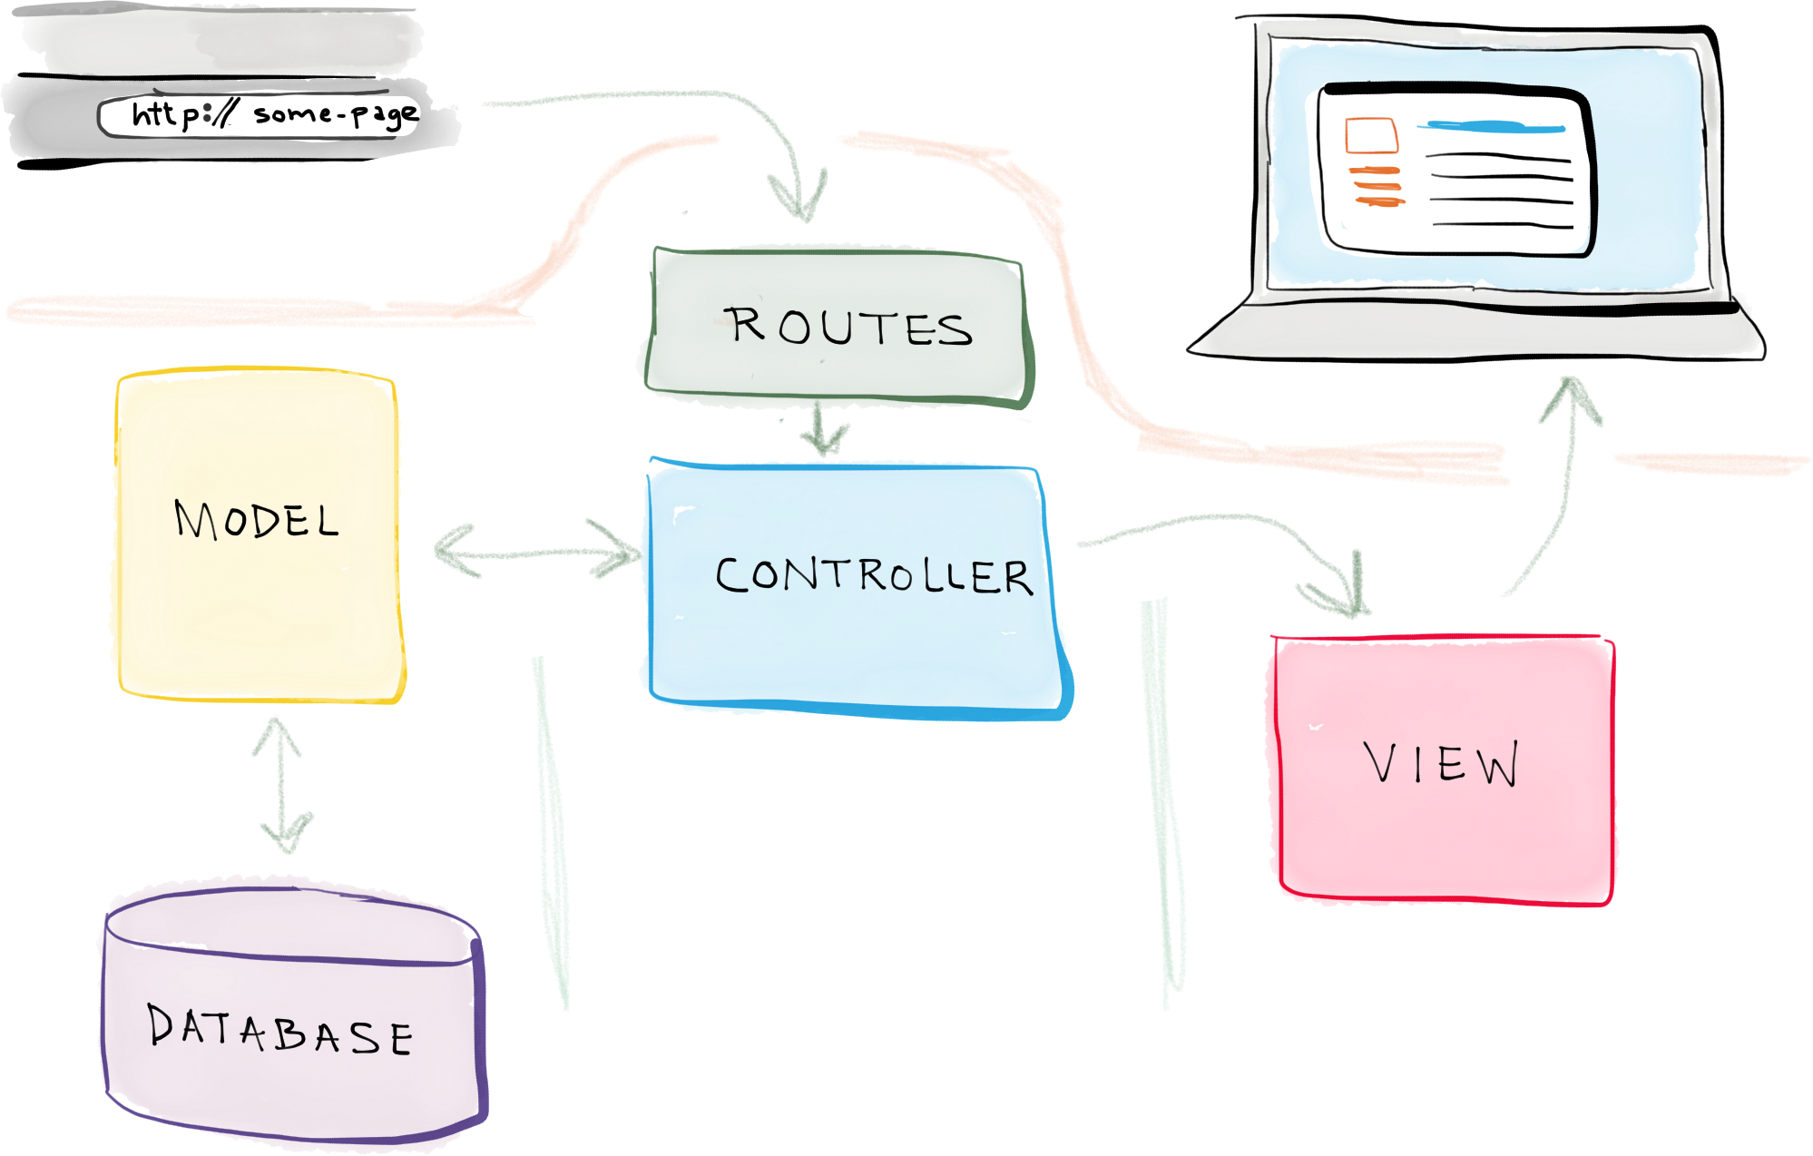
What you know as a novice...
https://realpython.com/images/blog_images/mvc_diagram_with_routes.png
Notes:
If learning language first is the route you take, then you can have a perfectly viable understanding of how to write an app, without any understanding of how to build one.
Here we have an example of a model view controller (MVC) setup, and this is probably the limit of what you know. You might know how to tie routes to handlers, and you might know how to use models to talk to your database, but the database itself is just a mysterious entity, and you have no idea how a particular route is called.

Slide 3
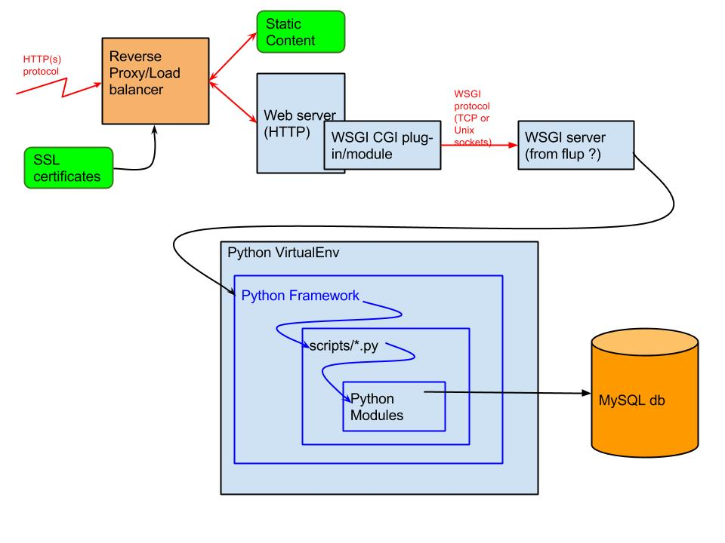
What’s actually going on, sorta
Python Modules = Most of the last slide
http://superuser.com/questions/822385/how-does-the-python-web-application-stack-work
Notes:
But if you zoom out, you see there’s a lot more happening when your appr runs. And everything in that graphic on the last slide is almost entirely contained right here in the Python Modules box. Clearly there’s a lot more going on.

Slide 4
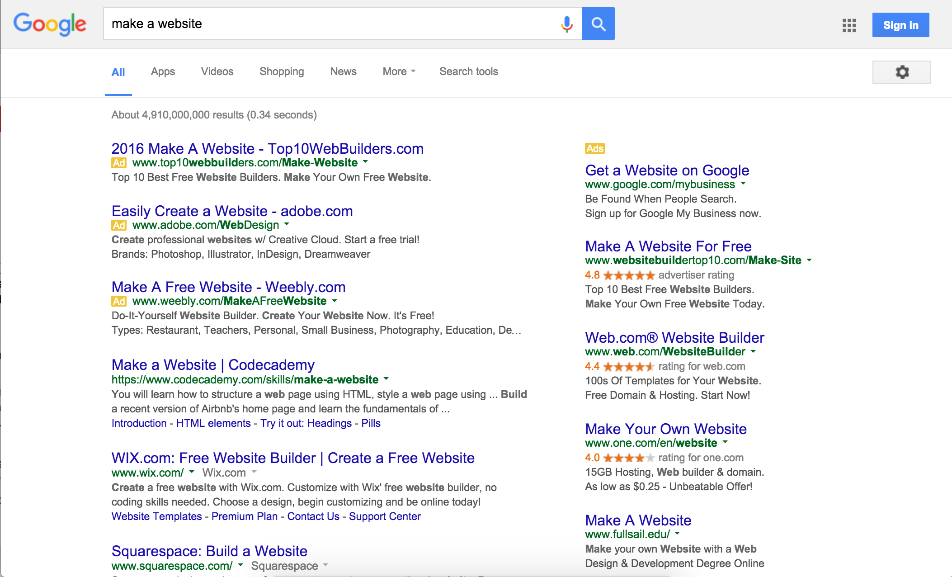
Notes:
And if you set out to teach yourself the rest of the story, you’ll find that comprehensive, easy-to-understand information on this aspect of programming is difficult to find on the internet.
It’s tough to know what to google. As a beginner, you don’t know the technical terms you need to search to get the best and most helpful results. Many of the results here have none of the meaty, back-end stuff you want for this sort of thing.
HTML-based or a WIX/Squarespace type of tool

Slide 5
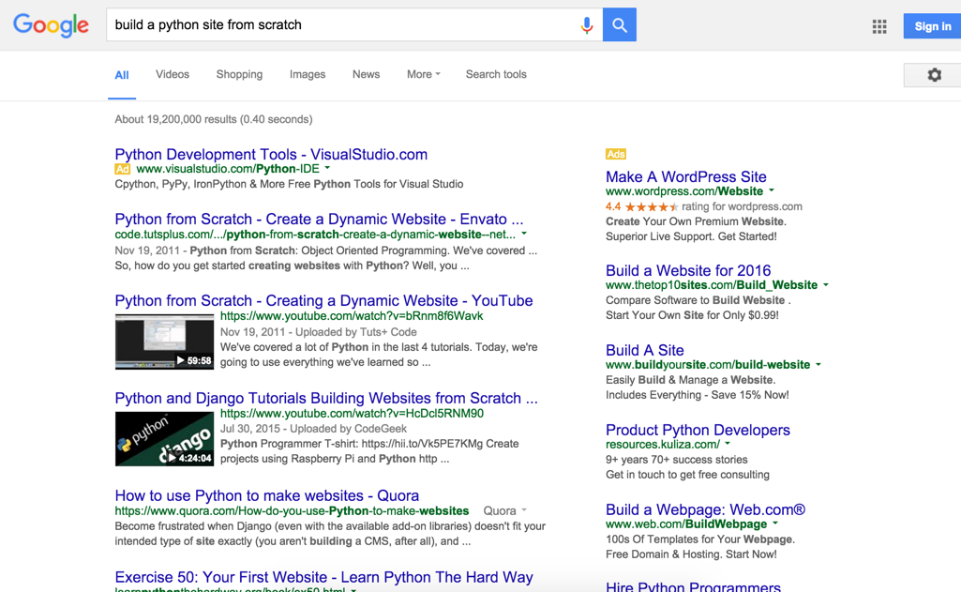
Notes:
Even when you do have a better query, many sites do not walk you through the full process
this one here makes no mention of virtual environments, for example
And the tutorials that exist only take you through one of the many possible combinations - here it’s Django and MySQL, which is not a bad way to go - but there are many others and it doesn’t really tell you that there are other options or what reason there is for choosing one over the other.

Slide 6
Say What??
“SQLite is a C library that provides a lightweight disk-based database that doesn’t require a separate server process and allows accessing the database using a nonstandard variant of the SQL query language. Some applications can use SQLite for internal data storage. It’s also possible to prototype an application using SQLite and then port the code to a larger database such as PostgreSQL or Oracle.” https://docs.python.org/2/library/sqlite3.html
Notes:
Finally, it’s hard to find tutorials that go into depth about what’s really happening behind the scenes in your computer or in your application. For more details, you are usually referred to the documentation, and the thing about software documentation is that it’s often very difficult for a beginner to understand.
Take this intro to the SQLite documentation. Say I’m a beginner programmer, trying to decide which database I should use for my app. There are a lot of words in here that, maybe a year ago, I wouldn’t have understood. I actually made this about six months ago and tried to emphasize the parts that I either at the time didn’t understand, or suspected I wouldn’t have six months to a year prior. The ones in italics are words that seem like jargon, and ones in bold are concepts that I just wouldn’t have known.
You have all these words here - Could I take a guess at their meaning? Sure, but not sure I really want to “guess” on something that could prove crucial to the app I’m building, or mess up my computer in some way, or any other host of things that could go wrong. Especially when I’m not really at the skill level where I feel confident I could fix something that went horribly wrong.
With that knowledge level, it is practically impossible to glean what this paragraph is saying, much less make a decision based on the information it provides.

Slide 7

Me
Notes:
Bringing it back to my knowledge level, when I was faced with wanting to actually build an app, this was me. I’d only worked in a well-established application
If I were to attempt to build and deploy my own web app, I wouldn’t have the first idea where to begin.

Slide 8

Notes:
So my goal with this talk is to provide a thorough, ground-up explanation of what to do when you want to create a web app, using as little jargon and as few buzz words as possible.
There are a lot of steps involved in this process, and a lot of options for each step. I will strive to explain the differences between the viable options so that you are empowered to make your own choices when building your next application.
To make things more digestible, I’m going to focus on virtual environments, package installation, database choices and how to configure your app to work with each of these pieces.
As a caveat, this talk is heavily biased toward Mac users.

Slide 9


Where R Ü Now?
Your operating system
(You)
Notes:
So, here’s you. At the start, you have an idea, and a computer. Let’s see what you can do.

Slide 10
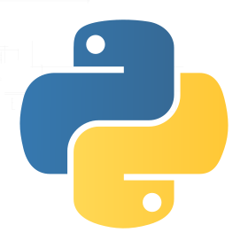
PyPI - the Python Package Index
Notes:
I’m going to start with package installers. They’re not necessarily the first step if, say, you already have a virtual environment package installed, but understanding these is important foundational knowledge for this talk.
The python standard library and the python ecosystem as a whole is full of packages that do anything from
help you manage your development environment, to
help you parse URLs within your app, to
communicating with your database...lots of super helpful things already coded and ready to go so that you don’t have to write these more repetitive bits yourself.
These can be found in the Python Package Index, AKA PyPI.
There are also frameworks you can install that automatically set up large parts of your application and make getting started much easier.
In order to access these packages, frameworks, etc., you need to install them. And there are a few ways to do that.

Slide 11
pip
easy_install
vs.
Notes:
Great debate - I’m not here to comment on it. Just want to explain how they work
Both allow you to easily install and manage Python packages
package/distribution subtle difference - distribution is what you download, the package is what you use in your app when you ‘import’
Distribution is whole setup including packages and dependencies, package is the core functionality you import that runs
Both work with setuptools’s setup.py to install packages onto your system or environment
There are some key differences and I’ll get into those, but first….

Slide 12
But what is setuptools?
Support for project dependencies and configuration
Included in Python
Notes:
Setuptools was built for the package creation side to make distributions easier, more consistent, and keep their dependencies up to date
So basically if you are writing a package to distribute on PyPI, setuptools can make your life way easier
It also works on the distribution download end to ensure pip and easy_install are able to access the information they need when installing distributions.
You don’t need to install setuptools, it’s included in python and updates intelligently when you need an update.
In an attempt to get a bit more granular - setuptools builds on top of the functionality of distutils. What is distutils? Well, I started to look into that, but stopped CHANGE SLIDE

Slide 13
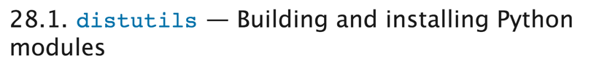
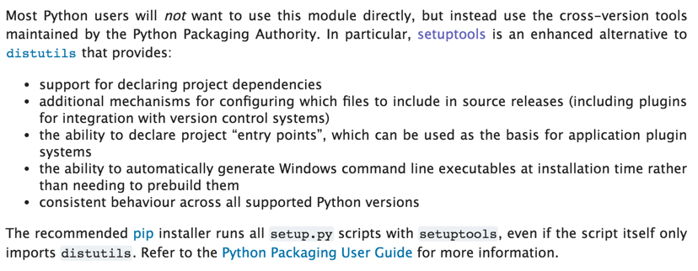
...
Notes:
when I saw that by the second paragraph of the distutils documentation it all but tells you to use setuptools instead, and then proceeds to list the benefits of setuptools
Despite this, people also have strong opinions about setuptools vs. distutils, but for the purposes of this talk, this is all you really need to know.

Slide 14
easy_install
Found in setuptools distribution*
Given a name, searches for a distribution with that name
Once found, it downloads the distribution using `setup.py install`
Checks whether newly installed distribution requires other libraries that are not installed; if so, finds them and installs them
Installs packages into the running version of python’s site-packages directory
Notes:
All of this is pretty similar to what pip does, nothing too hugely different here
Works with setuptools’s setup.py
Finds the distribution and required libraries
Installs into site-packages directory

Slide 15
easy_install
Modifies sys.path - a list of strings that specifies the search path for the currently installed modules
sys package = System specific parameters and functions
Populated from PYTHONPATH variable
Allows simultaneous installation of different versions of the same package into a single environment
More easily installs .egg files
Notes:
What’s different...
Modifies sys.path
sys.path is part of a python module called sys which helps set up system-specific definitions
sys.path generated from the PYTHONPATH variable
PYTHONPATH is an environment variable that influences python’s behavior and is specified in the command line environment, so it might be defined in your bash_profile
a list of strings that specifies the search path for the modules installed on your system or environment
So easy_install modifies sys.path to ensure it points to the appropriate version of a distribution
Allows multiple versions of a package in a single environment, that can be used by multiple projects so long as that project specifies which version it requires at runtime
So you can have multiple versions of a package, but if your program that requires the older version does not specify which version it needs, the code might execute based on the newer version of the package, which could break it. And I’ll touch in a bit more about those kinds of conflicts later.
.egg is just a file type that supports unicode and has a good compression algorithm

Slide 16
Several stages of `pip install`
Identify base requirements. The user supplied arguments are processed here.
Resolve dependencies. What will be installed is determined here.
Generates metadata on package dependencies using setuptools’s setup.py
Uses pkg_resources or setup.py `egg_info` to parse and read distribution and version requirements from this metadata
Assumes latest version that satisfies given constraints is best
https://pip.pypa.io/en/stable/reference/pip_install/#usage
Notes:
Takes arguments, resolves dependencies
What this means is it works with setup.py to generate metadata on package depedencies
When I say dependencies, what I mean is if your package requires other packages to run, those packages are your dependencies.
For example, pip might use pkg_resources to parse and read distribution and version requirements from this metadata
pkg_resources is a python module included in setuptools distribution. Provides ability to query metadata about distributions and where they’re installed.
Pkg_resources is a dependency of pip.
What this use of pkg_resources means is it finds a package, figures out what other packages that package relies on, and installs those as well, but unlike easy_install it will upgrade a version if it determines it necessary; it won’t allow multiple versions in a single environment.
As a rule, it assumes the latest version of a package that satisfies given constraints is the best version

Slide 17
Several stages of `pip install` con’t
3. Build wheels. All the dependencies that can be are built into wheels.
Wheels or .whl files are intended to replace eggs
4. Install the packages (and uninstall anything being upgraded/replaced).
Installs dependencies before their dependents
Installs using option `--single-version-externally-managed`, which forces setuptools to install it in a more flat manner than it would with easy_install -- i.e. eggs are a bit more difficult
Pip perk: Allows you to generate a requirements.txt file that specifies all required packages and their corresponding versions
https://pip.pypa.io/en/stable/reference/pip_install/#usage
Notes:
Builds wheels where it can

Slide 18


Eggs vs. Wheels
vs.
.egg
.whl
Notes:
Wheels/.whl files are meant to replace eggs
Wheel and egg are both packaging formats, significant to the installation process

Slide 19
Wheels
Versioned
Consistent installation
Performance optimizations
Better caching
Continuous integration
A single wheel can be both Python 2 and 3 compatible
Notes:
Wheel and egg are both packaging formats, significant to the installation process
documentation seems to favor wheel because it is more versatile - easier to change formats, also they are versioned
Wheels have faster and more consistent installation, performance optimizations such as better caching for testing and continuous integration
If pip is working with .eggs, it needs to grab egg_info from setup.py. Wheels avoid setup.py i.e. don’t run unnecessary scripts upon installation,
also create .pyc files on installation to ensure they match the python interpreter being used - single wheel can be both 2 and 3 compatible

Slide 20
Several stages of `pip install` con’t
3. Build wheels. All the dependencies that can be are built into wheels.
Wheels or .whl files are intended to replace eggs
4. Install the packages (and uninstall anything being upgraded/replaced).
Installs dependencies before their dependents
Installs using option `--single-version-externally-managed`, which forces setuptools to install it in a more flat manner than it would with easy_install -- i.e. eggs are a bit more difficult
Pip perk: Allows you to generate a requirements.txt file that specifies all required packages and their corresponding versions
https://pip.pypa.io/en/stable/reference/pip_install/#usage
Notes:
Continuing with pip..
Installs packages and uninstalls anything being upgraded or replaced, so you can’t have more than one version on a single environment
Installs dependencies (gleaned from the metadata) before dependents
Uses option --single-version-externally-managed, and here’s where eggs and wheels come in again. This option forces setuptools to install in a more flat manner as a wheel than it would with easy_install, which makes pip processing .eggs a bit trickier
Requirements.txt - Pip introduced the idea of requirements files. Pip generates a requirements.txt file that specifies all required packages and their corresponding versions needed for said package, and thus makes it much easier to replicate environments

Slide 21
Ok, great!
Notes:
So, great! You know the secrets now to install whatever packages you might need.
This is a huge step toward knowing how to build an app, but these packages can cause a lot of problems on your system or in your app if not managed correctly.
Many PyPI packages are actively maintained - iterate over time and have different versions
Sometimes new versions are backwards compatible, but sometimes not. Often there are issues if both are installed in the same system

Slide 22
Your operating system
App_1
App_2
SQLAlchemy v 0.9.6
SQLAlchemy v 1.1.0
query = session.query(Rings)
.filter_by(purpose=’to rule them all’)
Table headers = Name, Age
query.order_by(“age desc”)
query.one_or_none()
Notes:
While there are many different ways conflicting versions can mess you up, here’s an explanation of one of the simpler scenarios in which this could happen:
Your OS
App_1
Sqlalchemy is a package that helps you query and perform advanced operations on data in your database.

Slide 23
Virtual Environments!!!!!
Notes:
What’s the solution? Virtual environments!
Virtual environments allow you to install different versions of packages across your system and keep them isolated from one another so that apps that require different versions still work on your system, so long as they point to the appropriate virtual environment.
You can use pip and easy_install to get these going
Some people prefer not to use virtual environments
I would like to make a strong case for using them, esp. from a beginner’s perspective
If you are downloading something for purposes of development and you don’t know where it will be stored in your computer, or the extent of what it does, just play it safe and start up a VE before you start the download.

Slide 24
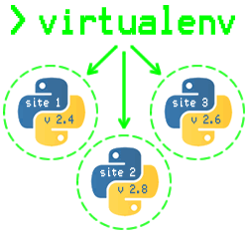
http://mitchfournier.com/2010/06/25/getting-started-with-virtualenv-isolated-python-environments/
Notes:
Virtualenv is one of the more widely used virtual environment packages in Python, so I’m using it here as an example to give a better idea of the larger concept of a virtual environment. I will touch on other types of virtual environments and isolation methods in a bit.
On a high level, you can think of them like this - see these three projects or ‘sites’ on your one system, and each of them is built on a different version of python and runs perfectly well on your computer.
Each virtual environment has its own Python binary, which means you can install whichever version of Python you want on each, and it will compile correctly
Virtual environments also have their own independent set of installed Python packages in its site directories.

Slide 25
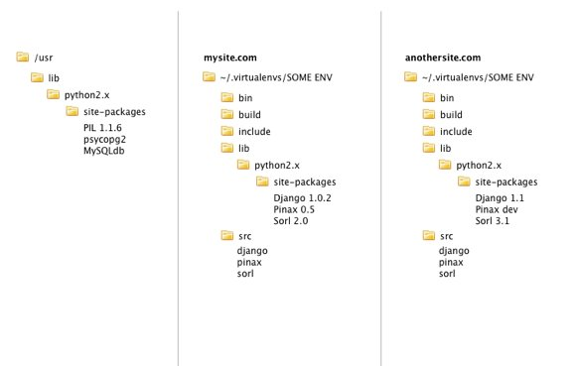
A bit more granular...
Notes:
This is more or less how your file system looks with virtualenvs installed
You have your normal system env on the left,
On the right you have two projects - mysite and anothersite
Each of these have their own virtualenv using different versions of Django, Pinax and Sorl and are living in harmony within one system.
If using a virtual environment, you don’t have to worry about different library versions, because for any one environment you will probably only need one version of a library.
However, on any one machine you probably need different versions, which is why installing packages system-wide is problematic for most libraries.

Slide 26
Hooray!
Notes:
Python makes setting up a virtual environment super easy. Here’s a bit more about what virtualenv actually does.

Slide 27
virtualenv
Works on any system that has python installed
~/ENV/lib/ and ~/ENV/include/
Contain supporting library files for a new virtualenv python.
~/ENV/lib/pythonX.X/site-packages/
Where packages installed in this environment will live
ENV/bin
Where executables live - noticeably the copy of python
Running a script with #! /path/to/ENV/bin/python would run that script under this virtualenv’s python.
Map chosen directory to your PATH variable in your bash_profile
Notes:
Virtualenv creates isolated python environments, each of which has its own python interpreter tailored specifically to the packages and python installed in that environment.
This package runs on your system’s python and standard library so will work on any system that has python installed.
It makes a copy of, optionally as specific version of, python and pip local to the active environment
Here are the standard paths that store the virtualenv files and important pieces of the package
With virtualenv, a global change to a library will not impact the code on your environment.

Slide 28
Virtualenvwrapper, etc.
Installs pip, python and setuptools upon creation
Shout out: virtualenvwrapper
ex. `workon env_name` vs. `source ~/ENV/env_name/bin/activate`
venv and pyvenv are built-ins of Python 3 that do essentially the same things as virtualenv
Notes:
virtualenvwrapper is an extension that makes adding, deleting, working on virtualenv and overall management of your dev workflow much easier if you’re a beginner, however the commands do obscure what’s actually happening, as seen in example so it depends how much you care about really knowing what’s going on
E.g. here you are calling source, which is a bash command that executes content of this file in the current shell, which allows you to “work on” the specified virtualenv
Highly recommend using if you go with virtualenv
venv/pyvenv - Don’t let these weird/new names confuse you - basically do very similar things. Particularly venv, which is python3’s version of virtualenv

Slide 29
pyenv
Bash extension
Intercepts your calls to python, pip, etc., to direct them to one of several of the system python tool-chains
Libraries included in any given version are always available
Good for switching between different versions of python
Notes:
pyENV
Bash extension so does not work on windows
Intercepts your calls to python, pip, etc. to direct them to one of several of your SYSTEM python’s tool chains
This does not happen within a virtual environment, so to speak. Instead, you point to which version of python you would like to use
Therefore, libraries included in any of the given versions you have installed are always available, can just grab from anywhere in your system
As such great for switching between versions

Slide 30
Virtual Environments: Key Takeaways
Virtual environments are a great way to prevent conflicts between dependencies of different apps you build on your machine.
~/ENV/ = a great directory in which to store your virtual environments
Virtual environments create folders in the path you designate and insert the supporting files you need to run your virtual environment in these folders
Once they are set up, you are free to install all the things!
Notes:
Virtual environments are a great way to prevent conflicts between dependencies of different apps you build on your machine.
~/ENV/ is a great directory in which to store your virtual environments, but it’s up to you, but a lot of the documentation you find will use that path, so using it yourself might make the documentation easier to follow
A virtualenv is installed in ~/ENV/ and telling your computer that, for whatever project you build on this environment, that said path is where to find that project’s dependencies, fully installed
Once set up, you’re free to install all the packages your app needs to run

Slide 31
Where R Ü Now?
Your operating system (includes its own version of python)
virtual environment (includes its own, separate version of python)
Packages!
Notes:
INTERACT
Right now it’s empty save for the python, pip and setuptools, but there’s lots of room for packages
This is a pretty good start. But there are other ingredients you need to build your own app, so let’s talk about those.

Slide 32
Database
Notes:
Another important part of your app is your database.
This isn’t necessarily the next step, although you could install database versions inside your virtualenv
But it’s tough to set up a database before you have an app structure in place. However, this knowledge will come in handy when we discuss app structure later
Which to choose?

Slide 33
Database Options (four of many)
PostgreSQL
MySQL
SQLite
(Oracle)
Notes:
Ton to choose from
Most common on here
For your purposes as a Python developer working on your own thing, likely just for fun or at least with a very small budget, you’ll probably be working with PostgreSQL, MySQL or SQLite. Oracle is pretty widely used, but it’s not open sourced and so will cost you more and be tougher to support, etc.
There are a TON more, but the first three are the main ones you’re likely to be working with.

Slide 34
SQLite
Included in python versions 2.7+
Does not require additional packages for support
Minimal setup
Stores entire database in a single file on disk
Supports only a single connection
Best for non-production
Notes:
SQLite is included in Python for versions 2.7 on, so it requires little set up and doesn’t require any additional packages for support, as MySQL and PostgreSQL do. Instead, it stores the entire database in a single file on disk. It also only supports a single connection. For those reasons, it’s much better suited to small pet projects that won’t ever get serious usage in a production environment.

Slide 35
PostgreSQL and MySQL
Recommended for python web apps
Open-sourced
Robust persistence schemas
Support:
Data replication
Advanced column types, ex. JSON
Sharding to allow horizontal scaling, read-write instances
Monitoring and other tools that will be useful in a web application
Not native to python = require third party packages to serve as a DB API so that the app’s python can interact with the database
PostgreSQL = psycopg
MySQL = mysql client
Notes:
PostgreSQL and MySQL recommended for Python web apps
Open-sourced
Have more robust persistence schemas than SQLite
Support data replication,
advanced column types like JSON,
sharding to allow horizontal scaling for when your rows get too long,
read-write instances,
monitoring and just a whole bunch of other tools that will be useful in a web application.
Because they’re not native to Python, require an API so that the application code can communicate with the database
ex psycopg for postgres, mysql client or another DB API client for mysql, cx_oracle for oracle.

Slide 36
Where R Ü Now?
Your operating system
virtual environment
Database, kind of just chillin, not connected to anything or even initialized
Notes:
INTERACT
Databases are great to have in your app and are stored in your system in various ways, but the important part to focus on for purposes of this talk is how it connects to and interacts with your app. And we’ll talk about that in the next part.

Slide 37
Web Frameworks: Benefits
URL routing
Matches an incoming HTTP request to a particular piece of python code
Request and response objects
Encapsulate the information received from or sent to a user’s browser
Template engine
Helps separate the python code from the frontend HTML output it produces
Development web server
Runs an HTTP server on development machines so that you can run your code locally
Notes:
There is not a definitive “right” way to set up your app’s file structure, but if you don’t wish to or don’t know how to design this part of your app yourself, you can use a framework.
In general, web frameworks aim to take care of some of the repetitive parts of app development, ex. provide libraries for database access
These are some of their main benefits, and these are important to keep in mind because if you decide not to use a framework and to build your own from the ground up, these are important functions you will need to build.
URL routing
Matches an incoming HTTP request to a particular piece of python code
Request and response objects
Encapsulate the information received from or sent to a user’s browser
Template engine
Helps separate the python code from the frontend HTML output it produces
Development web server
Runs an HTTP server on development machines so that you can run your code locally
Two popular python frameworks are Django and Flask

Slide 38
Django Default File Structure
foo/ manage.py
requirements.txt foo/ __init__.py settings.py urls.py wsgi.py
app_name/
__init__.py
models.py
[other files for MVC]
Notes:
INTERACT WITH SLIDE
If you’re curious, you can see how they do it here

Slide 39
Flask Recommended File Structure
app/
config.py requirements.txt run.py instance/ config.py yourapp/ __init__.py views.py models.py forms.py static/ templates/
Notes:
INTERACT WITH SLIDE
But I’m going to focus more on what these files actually do

Slide 40
Django
manage.py
Command-line utility for administrative tasks
mysite/__init__.py
Empty file that indicates mysite is a python package and should be treated as such
mysite/settings.py
Configuration for project
Database variables - DATABASE, ENGINE, NAME are set here
requirements.txt
Specifies which packages at which version your application uses
Standard file name so that other environments or installers know exactly where to find this information
mysite/wsgi.py
Notes:
To dive into what these files mean and do a bit, I will use Django as an example
manage.py uses is a command-line utility for administrative tasks. For example, it puts your project’s packages in sys.path, also sets the DJANGO_SETTINGS_MODULE variable to point to settings.py, and many other things. In this file you will find a list of all the available commands, but generally they serve to expose to you information and metadata about your app.
init.py indicates python package
settings.py configuration =
Database vars
ALso points to secrets, django templates, and wsgi

Slide 41
HTTP: A Short Story
Notes:
In order to understand WSGI, you have to have a basic understanding of HTTP, which I struggled with for some time as a beginner
HIGH level: The URL in your browser corresponds with a route in your app. In order to match the URL with the corresponding route, DNS has to happen, where basically this URL is sent as a request via a resolver, and is routed first to the top level domain server (i.e. the .com, .org, etc.), which then directs the resolver to a site’s name servers, which provide your site’s IP address.
This IP address maps to the servers that host your application.
The browser then sends the URL to those servers via an HTTP request. The server receives that URL and sends it to the web app, which processes that URL and matches it to the corresponding route, executes the appropriate code and returns an output with a bunch of information in it.
The server takes this output and sends it as a response under a bunch of different HTTP headers - the output that you see on your webpage is mostly stored under the “message” header

Slide 42
Web Server Gateway Interface (WSGI)
An object that responds to web servers
Not all app structures contain a file wsgi.py, but most web apps will need to have wsgi configured within the files of their basic app structure
A specification, laid out in PEP 333, for a standardized interface between Web servers and Python Web frameworks/applications
Goal: Provide a consistent, and relatively simple yet comprehensive interface capable of supporting all (or most) interactions between a Web server and a Web framework
Notes:
WSGI formalizes this communication via HTTP between web server and web application
Sometimes it’s its own file, other times it lives within the files of a basic app structure, e.g. app.py in Flask
Exists primarily to enforce consistent use of this relatively simple way to interact between web servers and web apps

Slide 43
Where R Ü Now?
Your operating system
virtual environment
Database, fully connected and initialized!
Your App!
settings.py
Package dependencies (requirements.txt)
WSGI.py
Packages
Web Server
Notes:
This is one of many ways you could set things up. If you want, your DB and your web server can both live inside your virtual environment, and there are plenty of other ways - it’s really a matter of your preference and what makes sense to you

Slide 44
If you remember anything...
Step 1: Create a virtual environment to isolate your packages and prevent version conflicts across different applications
Step 2: Pick a web framework to ease the overhead of starting an app, or create your application structure yourself if you’re feeling fancy
Step 3: Choose a database and connect it to your app
Notes:
Step 1: Create a virtual environment to isolate your packages and prevent version conflicts across different applications
Step 2: Pick a web framework to ease the overhead of starting an app, or create your application structure yourself if you’re feeling fancy
Step 3: Choose a database and connect it to your app
Now you know what to google; there are many reliable online tutorials that will help you through any of these steps (although very few that will help you with all three). Hopefully what you’ve learned in this talk will help you glean more information from these tutorials and to dive deeper on how this all works.

Slide 45
Sources
https://pip.pypa.io/en/stable/reference/pip_install/#usage
http://stackoverflow.com/questions/29950300/what-is-the-relationship-between-virtualenv-and-pyenv
http://pythonpaste.org/do-it-yourself-framework.html
https://howdns.works/
http://www.revsys.com/blog/2014/nov/21/recommended-django-project-layout/
https://docs.djangoproject.com/en/1.9/intro/tutorial01/
http://damyanon.net/flask-series-structure/

Slide 46
Questions?
Github: @naaaargle

